Slide 1

GDB

Slide 2

Workshop by
Liah Kim, Melody Yu, and Aryan Singh
Slides originally by:
Kristie Lim and Jonathan Myong

Slide 3
What is GDB?
GNU DeBugger
Like a debugger in XCode or Visual Studio, GDB lets you stop your program at certain points and look at variables. However, GDB is a command line tool (like ls or cd).

Slide 4

Fun Fact Slide
What does GNU stand for?
GNU's Not Unix
GNU's Not Unix
GNU's Not Unix
GNU's Not Unix
Notes:
From Wikipedia, "GNU's design is Unix-like but differs from Unix by being free software"
It's a recursive acronym o my

Slide 5
How will we use GDB in the lab?
You can use GDB as a debugger, but we'll be using it to analyze assembly code. We can:
View contents of registers
View contents at different addresses such as on the stack
Step through lines of assembly code

Slide 6
We'll be talking about the following commands:
Run
Breakpoints
Continue
Step
Print
Examine

Slide 7
DEMO/Walkthrough
Here's where you can download our demo program:
https://tinyurl.com/avengers33
Follow along!
Notes:
If you've read any gdb documentation, you would find that gdb is a lot. There are also many ways to do the same thing, so feel free to use whatever commands you're comfortable with. If you ever find yourself wanting to do something on gdb, just search up something like "view registers gdb." But the point of this workshop is to break down what I personally found most useful for the bomb lab.

Slide 8
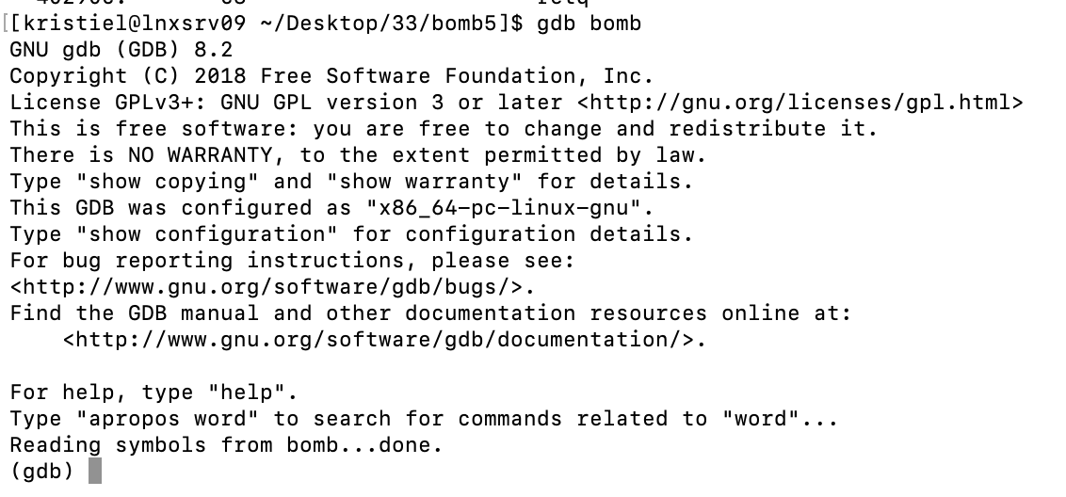
How to start gdb
In the folder that contains your executable, type gdb <executable_name>

Slide 9

How to quit gdb
Type quit and you'll return to your shell.

Slide 10
Run a program
For all of the following commands, assume you type them at the gdb prompt, after (gdb)
run
If you run the program without setting any breakpoints, it will run normally without stopping.

Slide 11
Running With Arguments
You may want to supply arguments to your program:
(e.g. ./my_program “hello”)
run “hello”

Slide 12
Repeatable Text
The bomb lab (and attack lab) will ask for you to supply input text.
This can get repetitive and is prone to error.
GDB allows you to supply a file as input, instead of you typing.
Each line of the file will correspond to one “prompt” by the program.
run < input.txt
Additional References: https://stackoverflow.com/q/4758175

Slide 13
Breakpoints
To stop the program at a particular point
break location
The argument for break can be a function name or an address. (It can also be a line number, but since you aren't given the source file, this is not very useful.)
Documentation: https://ftp.gnu.org/old-gnu/Manuals/gdb/html_node/gdb_28.html
Notes:
https://sourceware.org/gdb/onlinedocs/gdb/Set-Breaks.html

Slide 14
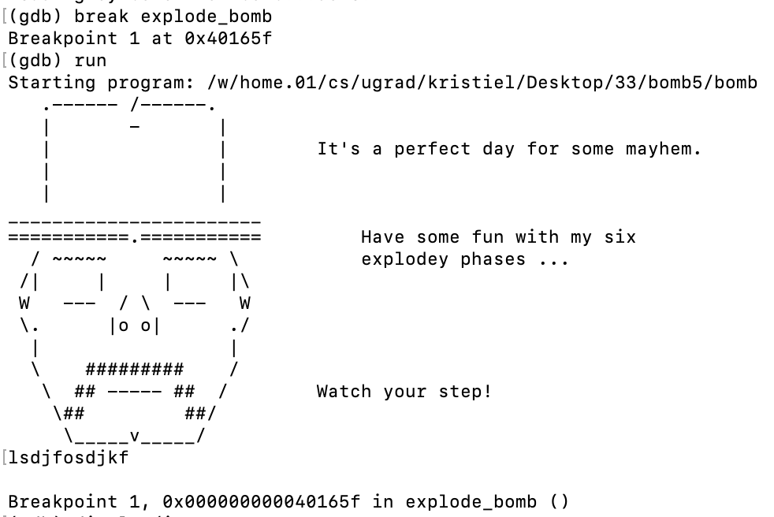
Breakpoints
Break at a function name
Notes:
https://sourceware.org/gdb/onlinedocs/gdb/Set-Breaks.html

Slide 15
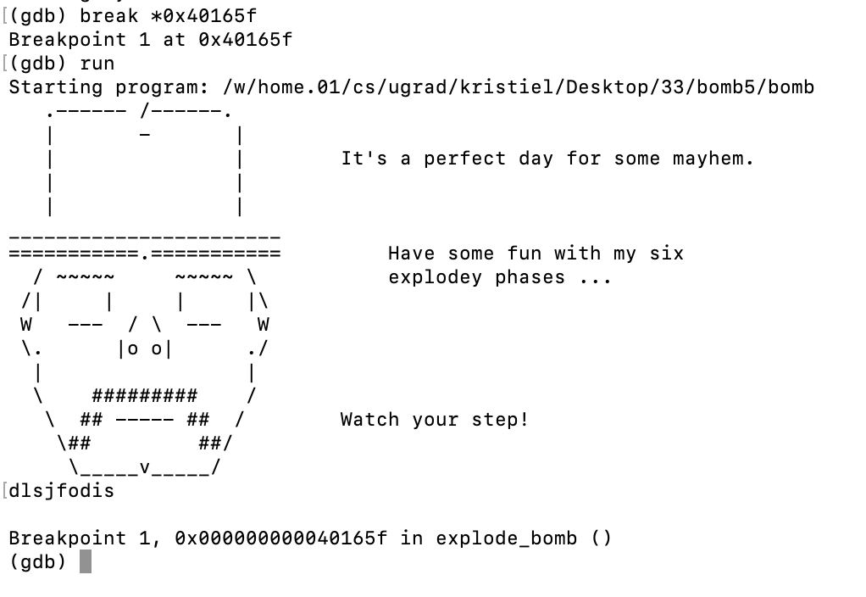
Breakpoints
Break at an address (note the asterisk)
Notes:
https://sourceware.org/gdb/onlinedocs/gdb/Set-Breaks.html
https://sourceware.org/gdb/current/onlinedocs/gdb/Address-Locations.html#Address-Locations

Slide 16

Short Form of Commands
Most commands in gdb will also have a short form, so instead of typing break, you can just type b.
The previous two commands, run and quit, can also be replaced by single characters.
Notes:
https://sourceware.org/gdb/onlinedocs/gdb/Set-Breaks.html

Slide 17
Disassemble
Produces the disassembled output of the specified function (like objdump)
disassemble <function_name>
The argument for disassemble is usually a function name. You can also run disassemble without an argument, but only when in a function. You can also give memory ranges.
Side tip: can also be called by disas
Side side tip: set disassemble-next-line on
Documentation: https://sourceware.org/gdb/current/onlinedocs/gdb/Machine-Code.html
https://visualgdb.com/gdbreference/commands/disassemble
Notes:
https://sourceware.org/gdb/onlinedocs/gdb/Set-Breaks.html

Slide 18
⚠ Bomb Lab Tip ⚠
Right when you start gdb, always type:
b explode_bomb
before doing anything else.
That way, when you run the bomb program, you will stop execution if you reach the explode_bomb function.

Slide 19
⚠ Bomb Lab Tip 2 ⚠
You can find the function names and signatures (i.e. argument types and return types) of a program by typing:
info functions

Slide 20
Continue
Keep running to the next breakpoint
continue
When at a breakpoint, continues running the program until another breakpoint, or the end

Slide 21
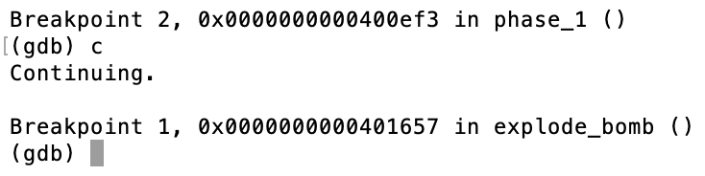
Continue
Until another breakpoint
Continue is abbreviated to c

Slide 22
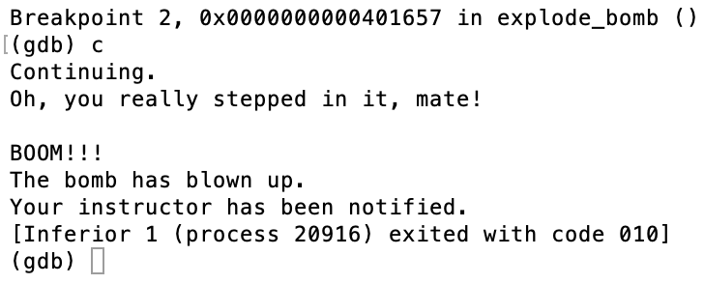
Continue
Until the end :(

Slide 23
Step
Executes line by line
step
Runs one line in the source code, and stops and return

Slide 24
Step
step count
The count argument is optional, and allows for stepping through multiple lines

Slide 25
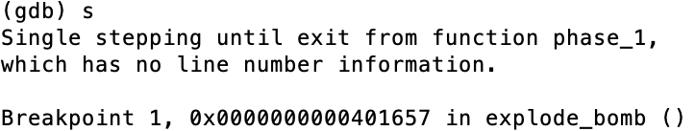
Step
Without line number information given, acts like the command “continue”
Step is abbreviated to s

Slide 26
Stepi
Executes instruction by instruction
stepi
Runs one machine instruction, and stops and return

Slide 27
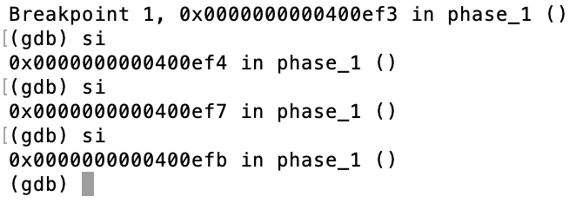
Stepi
Stepi works even without line number information
Stepi is abbreviated to si
Notes:
https://unix.stackexchange.com/questions/297982/how-to-step-into-step-over-and-step-out-with-gdb

Slide 28
Next
Also executes line by line...with one difference
next
Runs one line in the source code, but doesn’t “step into” functions. IE, proceeds through subroutine calls.
Like step, can also be run with the [count] argument

Slide 29
Nexti
Executes instruction by instruction, proceeding through subroutine calls
nexti
Runs one machine instruction, and stops and return

Slide 30
Print
To print the value of registers (and other variables)
p/format what_to_print
The argument for break can be a register or some number. (It can also be a variable name, but since you aren't given the source file, this is not very useful.)

Slide 31
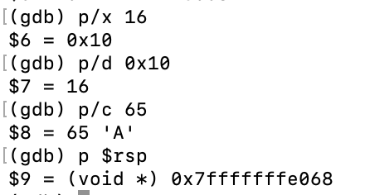
Format
The character after the slash that says how to format the argument
Some format characters:
x for hexadecimal
d for decimal
c for character
nothing for default
Full list of output formats: https://ftp.gnu.org/old-gnu/Manuals/gdb/html_node/gdb_54.html

Slide 32
Print
Don't forget the dollar sign when printing a register. Also note that there is no % sign.
p $rax

Slide 33
Examine
Take a look at what an address points to
x/nfu address
number format unit

Slide 34
Examine
The nfu options are optional, and default values will be passed in if you don't have one or more of the characters.
Some particularly useful formatting characters for x:
s string
i instruction

Slide 35
Examine
Example:
View 10 instructions from the current instruction
x/10i $rip
gdb will default to the last format you used if no format is specified
$pc (for program counter) is the same as $rip if you want to type one less character.
If you don't put a number, it will default to 1.

Slide 36
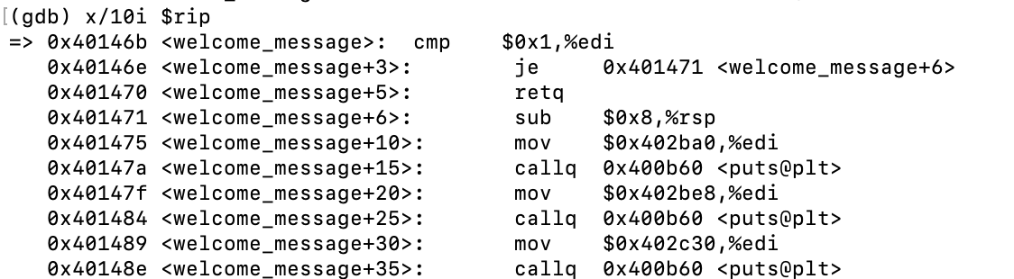
Examine
Example:
View 10 instructions from the current instruction

Slide 37
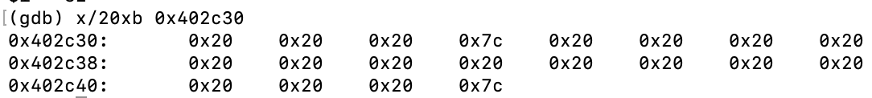
Examine
Example:
View 20 bytes in hexadecimal at a particular address (b stands for bytes, it is often the default)
x/20xb 0x402c30

Slide 38
Examine
Example:
View string stored at particular address
From running the previous command, I know that 0x402c30 is moved to %rdi (the parameter register) before calling puts (function used to print), so let's examine the memory at this address as a string!
x/s 0x402c30

Slide 39
Examine
Note that this is the exact same address, just formatted differently.
Each byte represents a character. (0x20 is the ASCII character for space and 0x7c is the vertical bar). You could manually figure out the string by looking up the characters in an ASCII table, but GDB does this for you!

Slide 40
And more...
You might find other gdb commands useful too, and we encourage you to explore. Here are even more commands:
disassemble
Show a disassembled function
https://ftp.gnu.org/old-gnu/Manuals/gdb/html_node/gdb_49.html
display
Useful defaults for p and x, more display options
https://ftp.gnu.org/old-gnu/Manuals/gdb/html_node/gdb_56.html
backtrace
View which functions you're in
https://ftp.gnu.org/old-gnu/Manuals/gdb/html_node/gdb_42.html
info registers
Print values of all registers
https://stackoverflow.com/questions/5429137/how-to-print-register-values-in-gdb
GDB cheat sheet: http://csapp.cs.cmu.edu/2e/docs/gdbnotes-x86-64.pdf
Notes:
If you've read any gdb documentation, you would find that gdb is a lot. There are also many ways to do the same thing, so feel free to use whatever commands you're comfortable with. If you ever find yourself wanting to do something on gdb, just search up something like "view registers gdb." But the point of this workshop is to break down what I personally found most useful for the bomb lab.

Slide 41
Slides:
https://docs.google.com/presentation/d/1mUR75UbBu6btTzC04bI8zY0FE9almjGUcFVZq3fwOLw

